Slide 1
Lesson 1: Drawing Lines

Slide 2
Name different lines
Draw different lines
Use lines to draw lollies

Slide 3
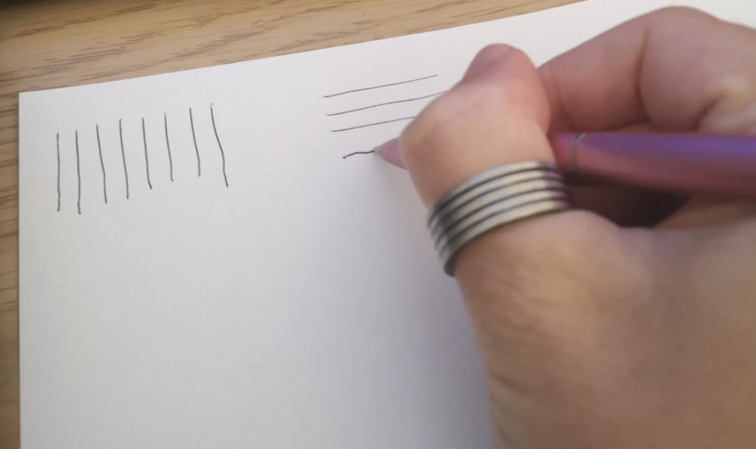
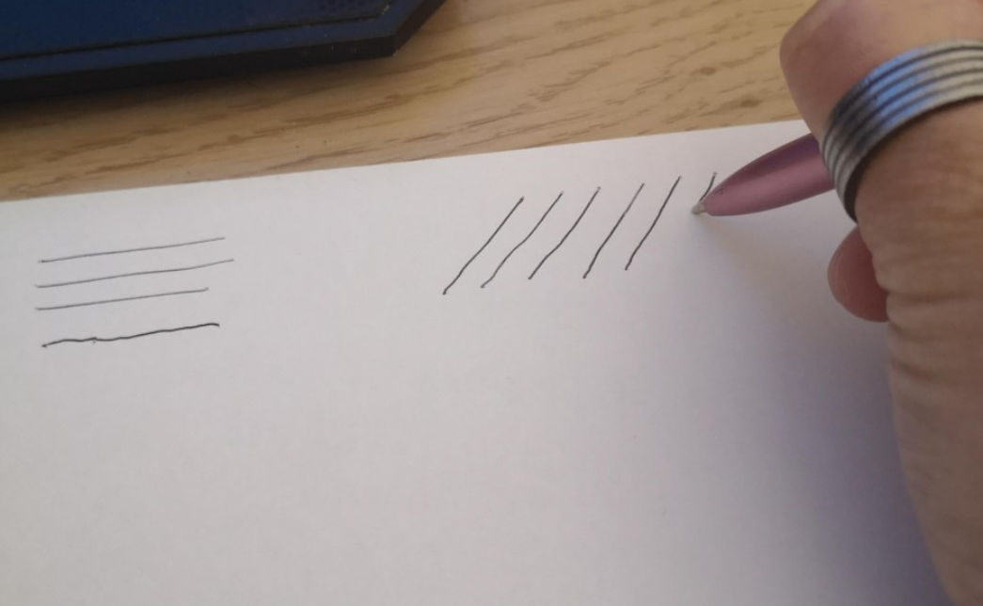
Lines
When we draw, we use lines. Here are some lines. With your adult, have a go at naming them.
Now have a go at drawing some vertical, horizontal and diagonal lines on your paper, like me.

Slide 4
Lines
Click the videos to watch me draw some wavy lines and zig-zag lines. Now you try!
Here are some wavy lines. Here are some zig-zag lines.

Slide 5
Let’s draw some tasty lollies!
You can have a go at drawing the outline or ask someone to help you.
Don’t worry if you go a bit wrong or draw wobbly lines. It makes your drawing more interesting!

Slide 6
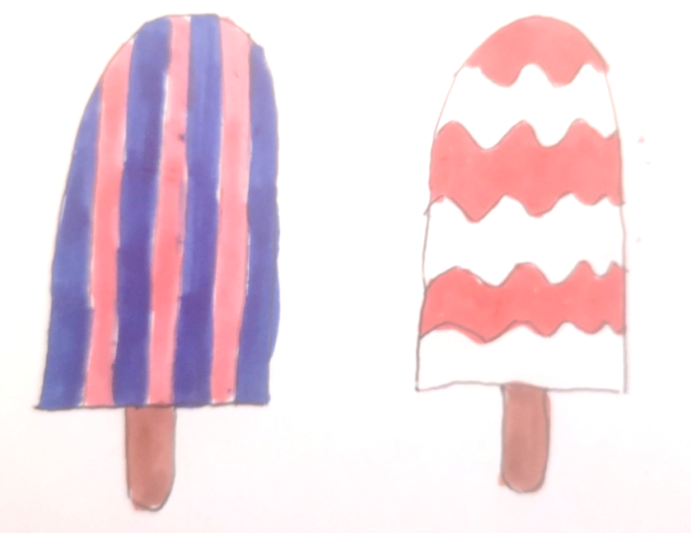
How many designs can you make?
If you have colours you can colour them in.
Don’t worry if you don’t, they still look great!
Good enough to eat!

Slide 7
You’ve now completed today’s lesson well done!

