Slide 1
Lesson 4: Line Hunt

Slide 2
Review: Line drawing & making patterns 1
Review: Line drawing & making patterns 2
Line Hunt!

Slide 3
Lines
A line is a path that a point takes through space.
Lines can be thick, thin, dotted or solid.
They can make straight movements, zig-zags, waves or curls.

Slide 4
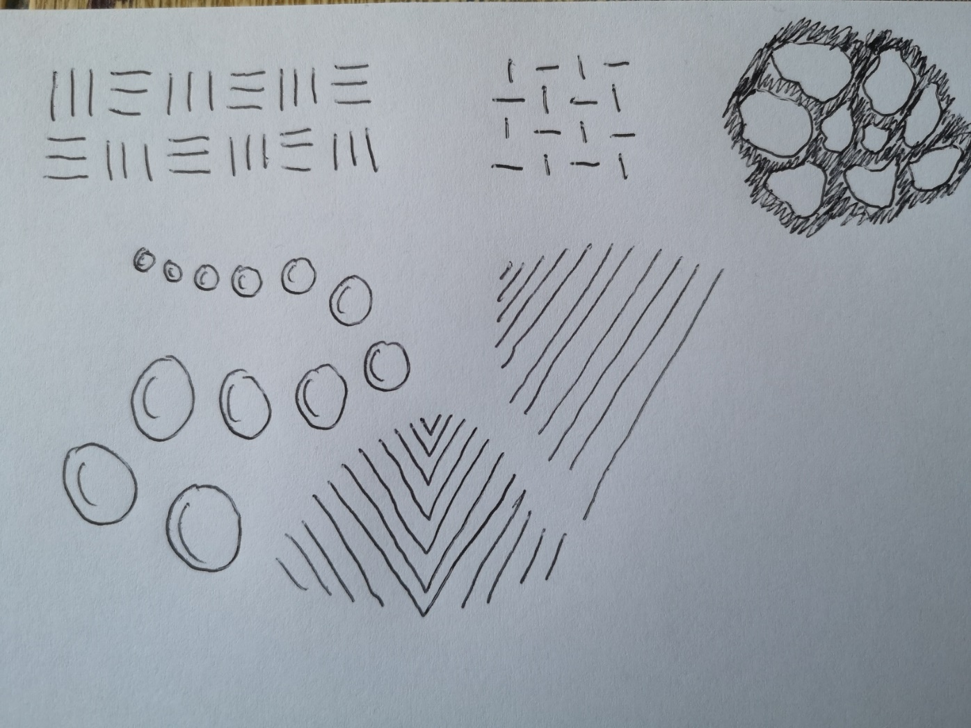
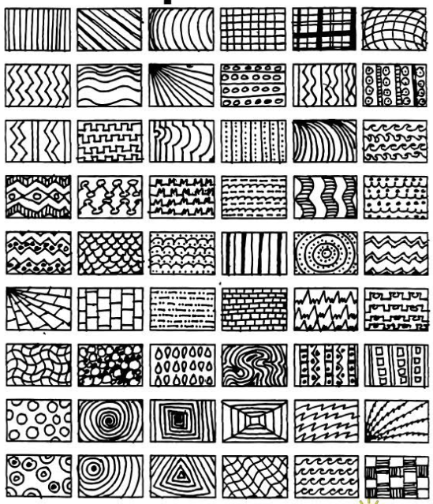
Recap: Line Drawing and Making Patterns
Can you remember that in the last lesson, we practised using lines to make patterns?

Slide 5
Choose 6 boxes to copy the pattern.
Lines are used to make texture. Texture is how an object feels if we were to touch it.
For example, does it feel smooth, soft, bumpy or prickly?
We’re going to look a drawing that uses lines to create texture and interest….

Slide 6
Line Hunt!
Have a look at this drawing.
What can you see?
This drawing is made up of different lines: wavy, straight, scribbled etc.
Let’s look at a part closely…
credit: Erin Morley-Smith @allthroughart

Slide 7
I’m going to have a go at copying some of the lines I can see.
You have a go, too. You can use pencil or pen.

Slide 8
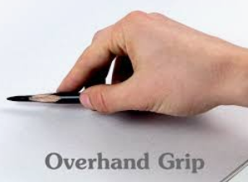
Have a look at the lines I’ve spotted in the drawing. Try and find and copy as many as you can!
Tip: to get a thicker line, hold your pencil using an overhand grip.

Slide 9
You’ve now completed today’s lesson well done!

